Slide 1
2D Shape Extraction
From 3D STL to 2D Matlab Shape
Project Team:
Calvin Boyle
Jae-Seok Oh
Kyshalee Vazquez-Santiago

Slide 2
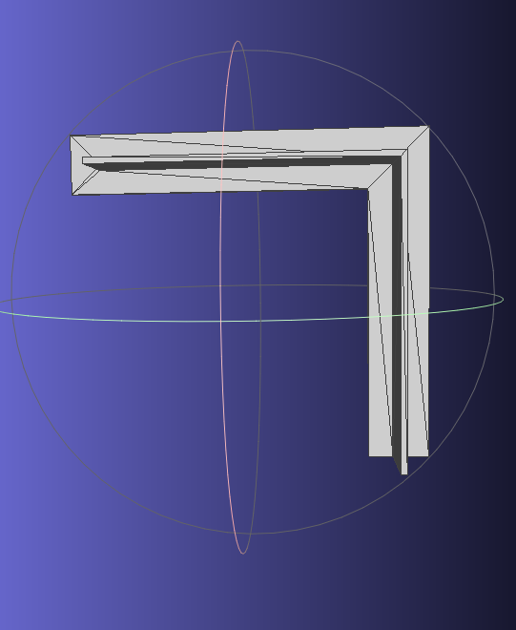
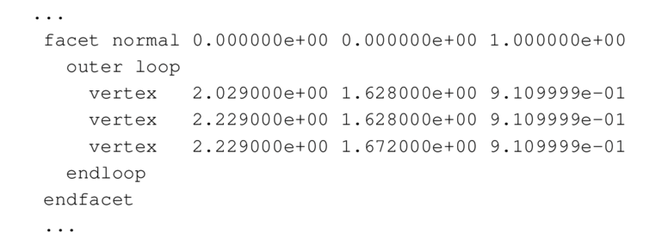
What will the proposed project do?
3D CAD model view
Sample: ASCII STL file from CAD

Slide 3
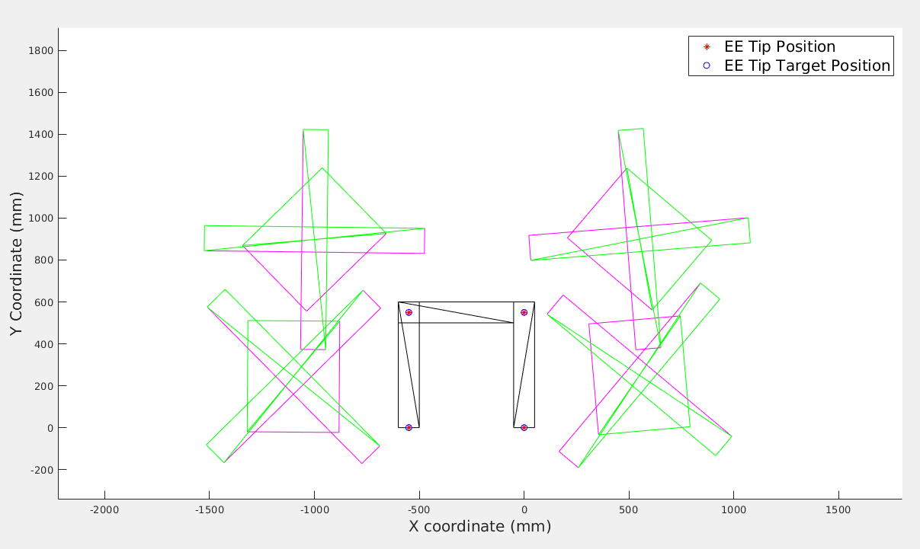
Parse through STL file and extract features (e.g outer shape of top-view)
Visualize in 2-D coordinates
Collision detection in softwares (MATLAB, etc)

Slide 4
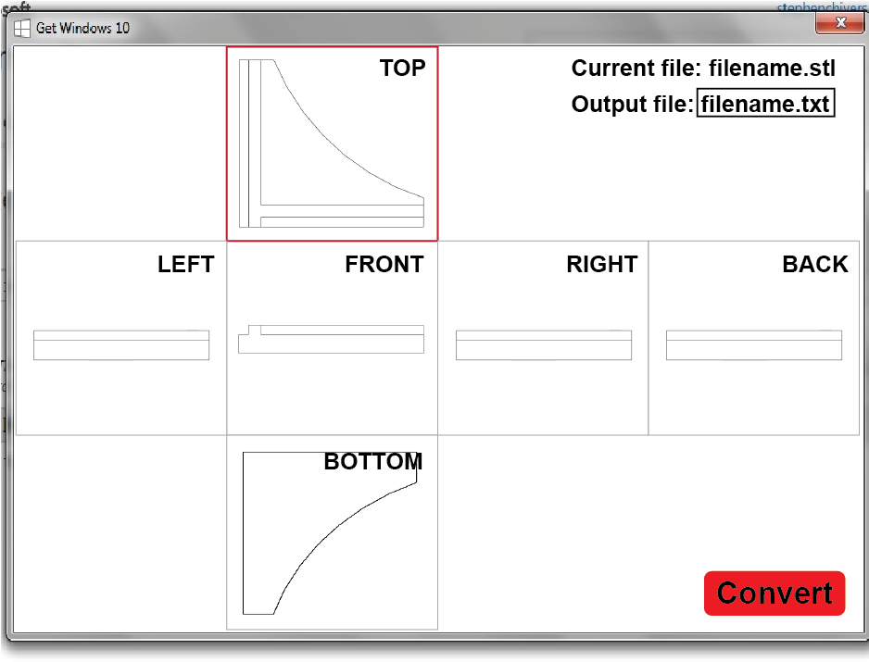
What will the proposed project do?
3D model display + 6 primary views
View selector cube or select for projections
Loop selection to break up parts

Slide 5
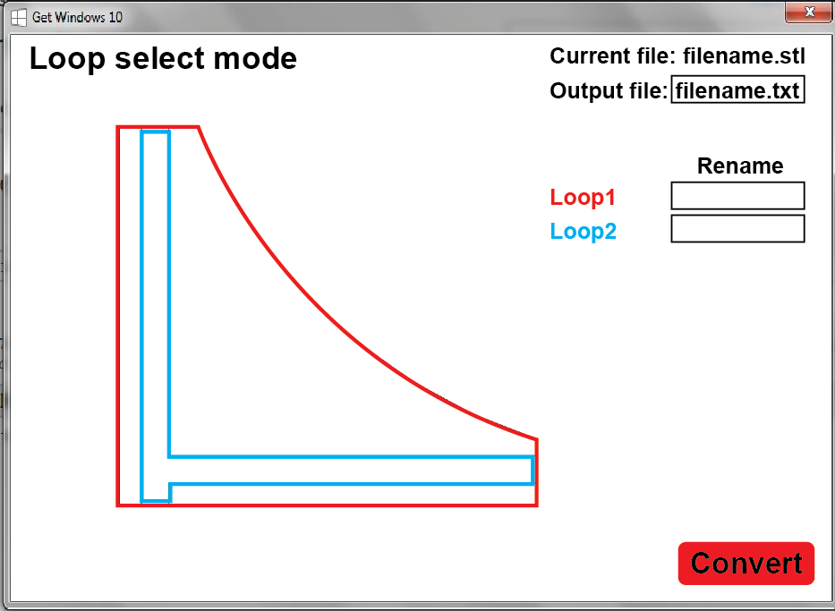
What will the proposed project do?
3D model display + 6 primary views
View selector cube or select for projections
Loop selection to break up parts

Slide 6
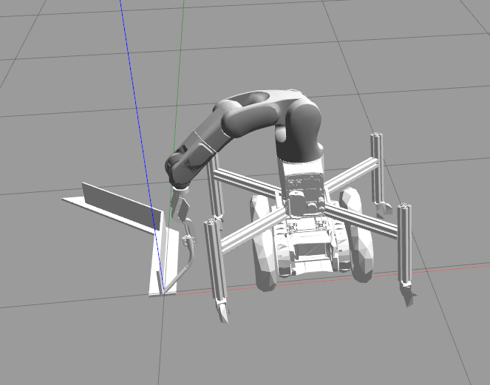
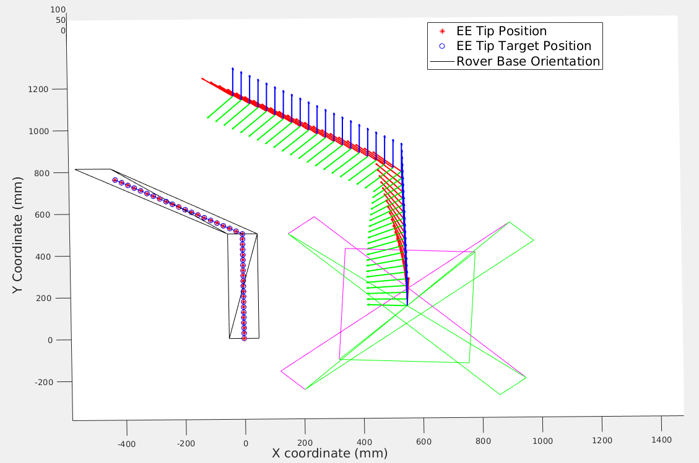
Why this topic?
Gazebo Simulation with imported CAD
Autonomous welding with mobile manipulators is a CERLAB research topic.
CAD model of parts for welding.
Motion planning is generated in MATLAB.
Geometric approach for collision avoidance.
Manually defining in MATLAB the outer shape of a 3D CAD is time consuming.
Matlab environment 2D projection

Slide 7
Is the project of reasonable difficulty?
Project features:
Parsing of numerical data from STL text.
Evaluation and Detection of outer Shape of model.
Detection of welding path.
3D rendering of a CAD model.
Interactive component for selection of projection surface.
Project features will provide the opportunity to apply concepts from courses 24780 and 24783.

